Slide 1
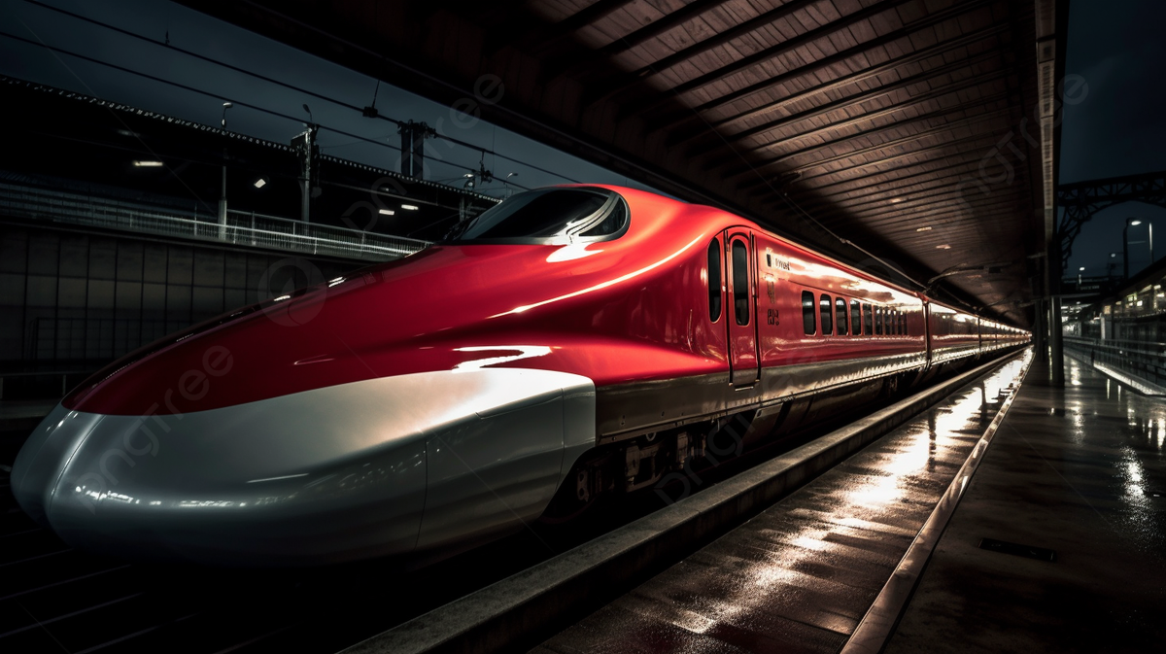
UK train Rides Analysis jan-April 2024
By : Amish Ilyas

Slide 2
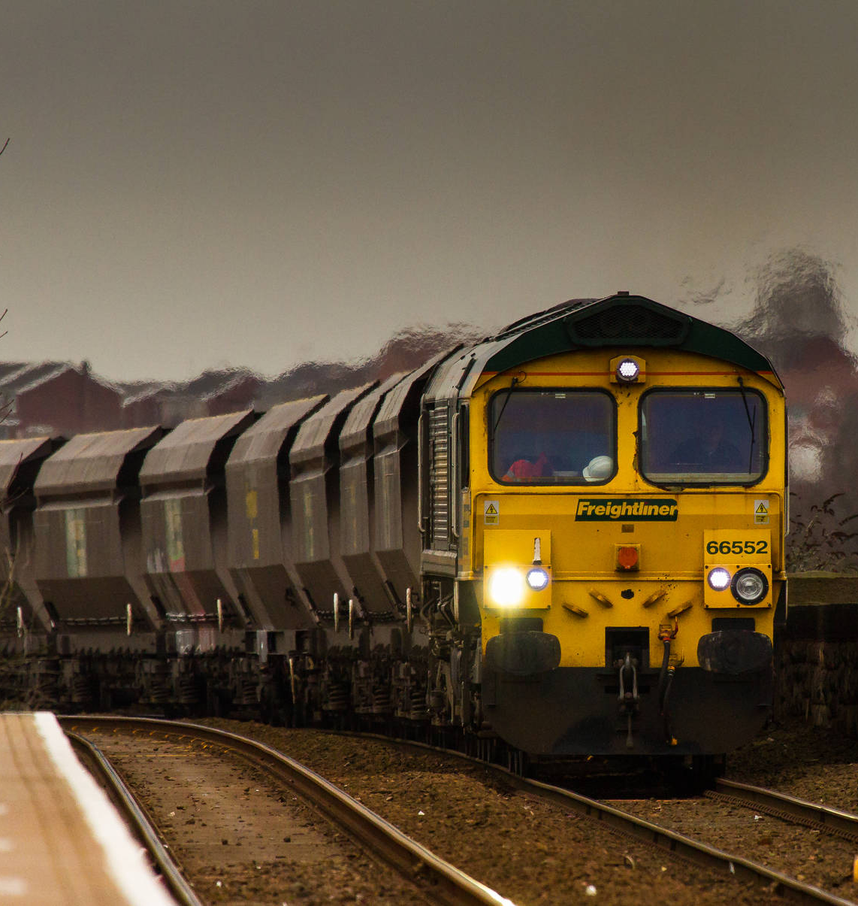
agenda
Problem Statement
Dataset Overview
Analysis
Hypothesis Testing
Suggestions

Slide 3
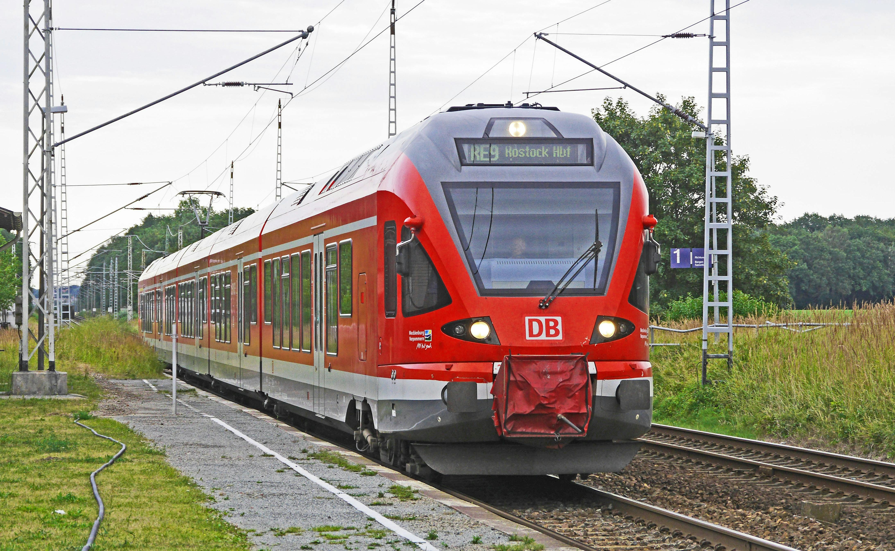
Problem Statement
Identify the factors contributing to train delays and cancellations and their impact on customer refund requests, in order to improve the punctuality of National Rail services and optimize pricing strategies from January to April 2024.

Slide 4
Dataset Overview
Mock train ticket data for National Rail in the UK, from Jan to Apr 2024, including details on the type of ticket, the date & time for each journey, the departure & arrival stations, the ticket price, and more.
This data contains column:
Transaction ID: Unique identifier for an individual train ticket purchase
Date of Purchase: Date the ticket was purchased
Time of Purchase: Time the ticket was purchased
Purchase Type: Whether the ticket was purchased online or directly at a train station
Payment Method: Payment method used to purchase the ticket (Contactles, Credit Card, or Debit Card)
Railcard: Whether the passenger is a National Railcard holder (Adult, Senior, or Disabled) or not (None). Railcard holders get 1/3 off their ticket purchases.
Ticket Class: Seat class for the ticket (Standard or First)
Ticket Type: When you bought or can use the ticket. Advance tickets are 1/2 off and must be purchased at least a day prior to departure. Off-Peak tickets are 1/4 off and must be used outside of peak hours (weekdays between 6-8am and 4-6pm). Anytime tickets are full price and can be bought and used at any time during the day.

Slide 5
Dataset Overview
Price: Final cost of the ticket
Departure Station: Station to board the train
Arrival Destination: Station to exit the train
Date of Journey: Date the train departed
Departure Time: Time the train departed
Arrival Time: Time the train was scheduled to arrive at its destination (can be on the day after departure)
Actual Arrival Time: Time the train arrived at its destination (can be on the day after departure)
Journey Status: Whether the train was on time, delayed, or cancelled
Reason for Delay: Reason for the delay or cancellation
Refund Request: Whether the passenger requested a refund after a delay or cancellation

Slide 6
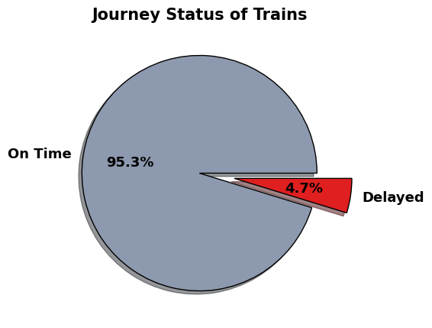
Analysis
By Observing the Journey Status Visual of Train it can be seen that On Time Trains are 95.3% and Delayed Trains are only 4.7% which is not a big Percentage but . It’s an issue for the Trains company .

Slide 7
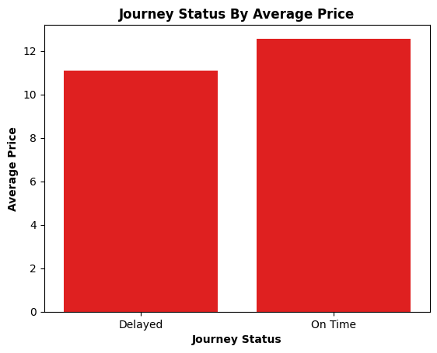
Analysis
By Observing the Journey Status By Average It can be seen clearly that Delayed Trains have less Average Price as Compared to On Time Trains . Maybe Because of The Issues in Trains these trains have less Price.

Slide 8
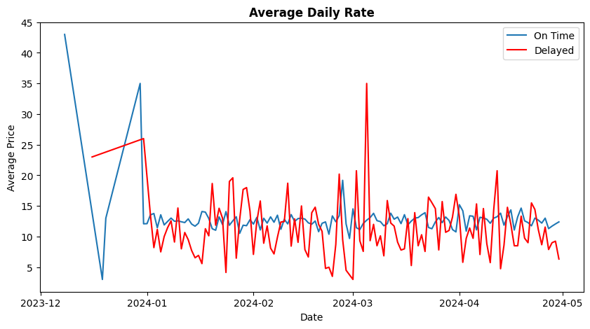
Analysis
By Observing the Daily Average Rate By Delayed and On Time of trains we can see that there are very much ups and downs in average price of Delayed Trains.

Slide 9
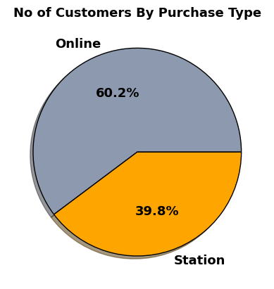
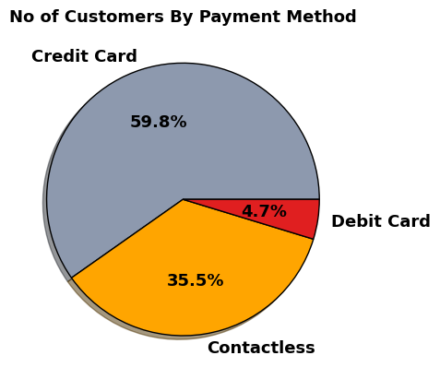
Analysis
We can See that Most of the Customers are those who purchase Tickets online 60.2% and 39.8% customers purchase Tickets from Station . We can Also See that Most of the Customers Buy Tickets From Credit Card Payment Method 59.8% and Contactless method is 35.5% and Debit Card Payment Type is Least used by Customers which is only 4.7 %

Slide 10
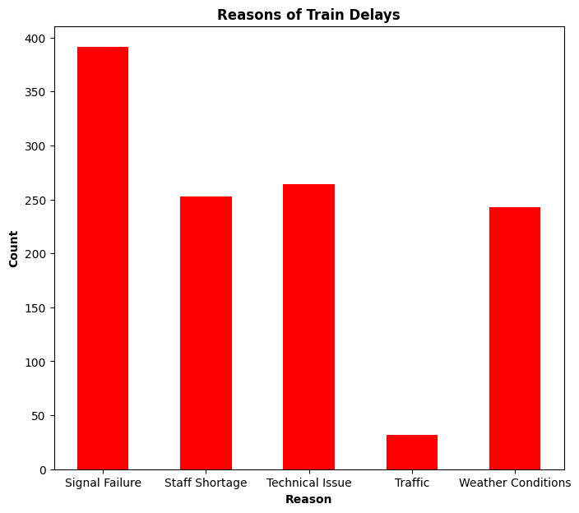
Analysis
As we can see the Reason for Train Delays most of the issues are of Signal Failure , Technical Issues Staff Shortage and Weather Conditions the Least issues are of Traffic

Slide 11
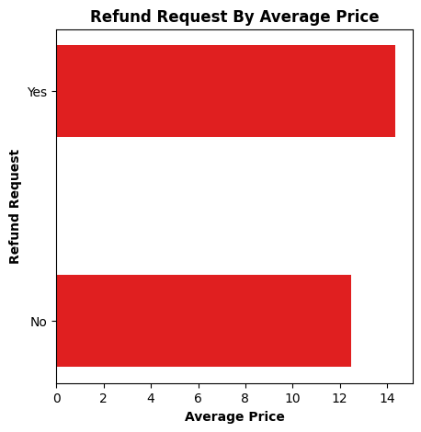
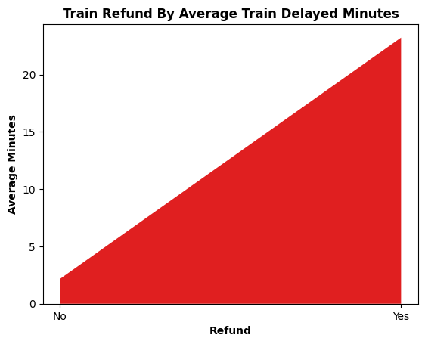
Analysis
By Observing the Figures of Refund Request By Average Price and Train Refund Average Train Minutes we can see that Average Price has Impact on Refund Request to some extent and Delayed Minutes Also has effect on Refund Request .

Slide 12
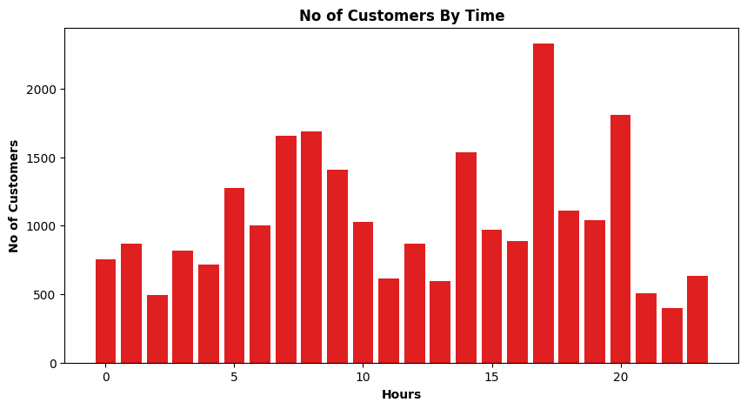
Analysis
By Observing the Visual of No of Customers By Time we can see that 14,17 ,20,7,8,9 are peak hours of Customers when they Purchase Ticket by using this information we can draw further insights.

Slide 13

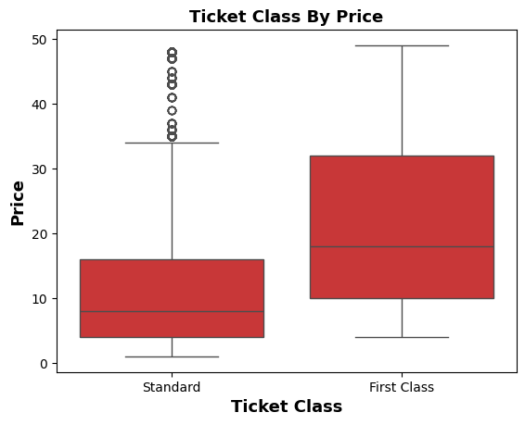
Hypothesis Testing
P-Value
By Observing the P-value and by looking at the Chart we can observe that there is a significant difference between the average price of Standard and Frist Class Ticket.

Slide 14
Suggestions
We Saw that Average Price of Ticket of Train of On Time are stable but there were many ups and downs in the average price of Delayed Trains This needs to be investigated why this is happening
60.2% Customers are booking Tickets Online so the companies can go for digital marketing strategies to attract more customers 39.8% customers are booking train tickets offline from station so companies can go for ads posters and can attract more customers.
Most Used Payment type by Customers are Credit Card 59.5% and Contactless 35.5% and the least payment is made by debit cards So they can work on the strategies to improve Credit Card and Contactless Strategies and they should specially work why people are using debit card Payment method Least.

Slide 15
Suggestions
Most of the Reasons for Delayed Trains are Signal Failure , Staff Shortage , Technical Issues , Weather Conditions and Least one is Traffic . A complete investigation is needed to find out the reason Behind Signal Failure why it is happening , also there is need of more staff hiring to resolve staff issues . More Tech persons should be hired to resolve any issues related to Technology. Weather Conditions cannot be controlled but we can prepare everything for the bad weather conditions like equipment etc. For Traffic issues Train companies can contact to the Traffic management departments for resolving Traffic Related issues.
Peak Hours for Train Booking are 14,17,20,7,8,9 in these hours there should be proper equipment , staff and everything related to Trains Because in this way we can reduce Delaying of Trains and make the bookings not get cancelled on other hours companies should provide special offers to attract customers.

Slide 16
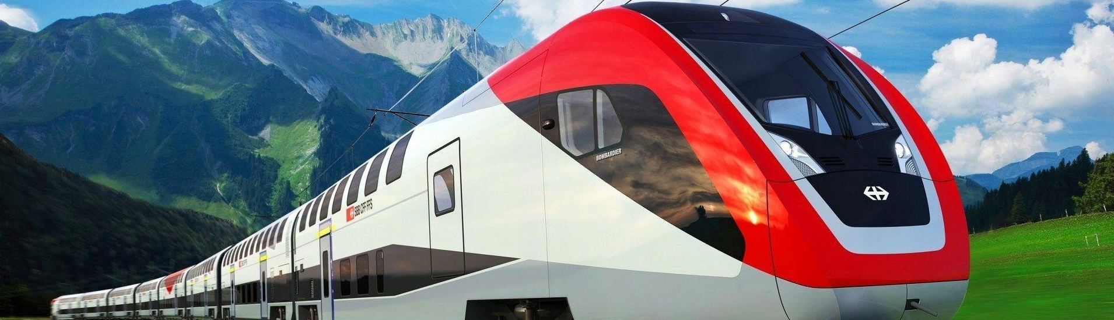
contact info
Amish Ilyas
ilyasamish@gmail.com

